Slide 1
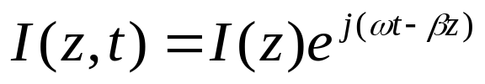


Laser Operation & Lasing Condition
To determine the lasing condition and resonant frequencies, we should focus on the optical wave propagation along the longitudinal direction, z-axis. The optical field intensity, I, can be written as:
Lasing is the condition at which light amplification becomes possible by virtue of population inversion. Then, stimulated emission rate into a given EM mode is proportional to the intensity of the optical radiation in that mode. In this case, the loss and gain of the optical field in the optical path determine the lasing condition. The radiation intensity of a photon at energy varies exponentially with a distance z amplified by factor g, and attenuated by factor according to the following relationship:
[4-19]

Slide 2




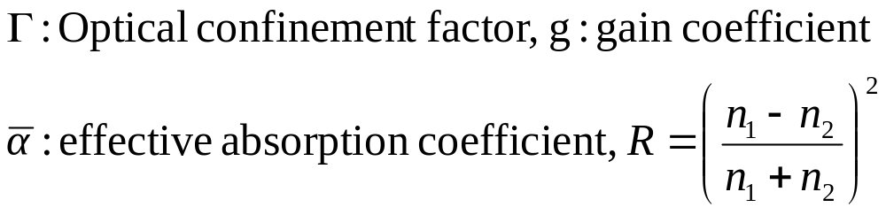
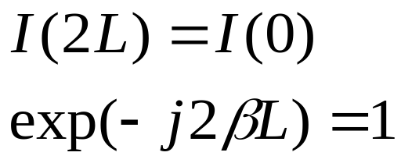
[4-20]
Z=0
Z=L
[4-21]
Lasing Conditions:
[4-22]

Slide 3
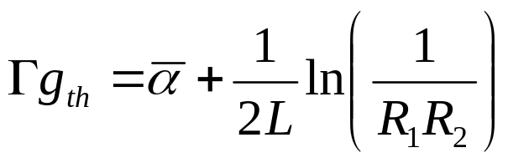
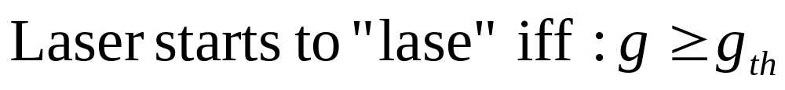
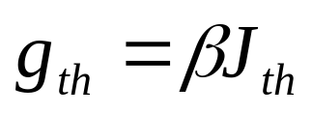
Threshold gain & current density
[4-23]
For laser structure with strong carrier confinement, the threshold current
Density for stimulated emission can be well approximated by:
[4-24]

Slide 4
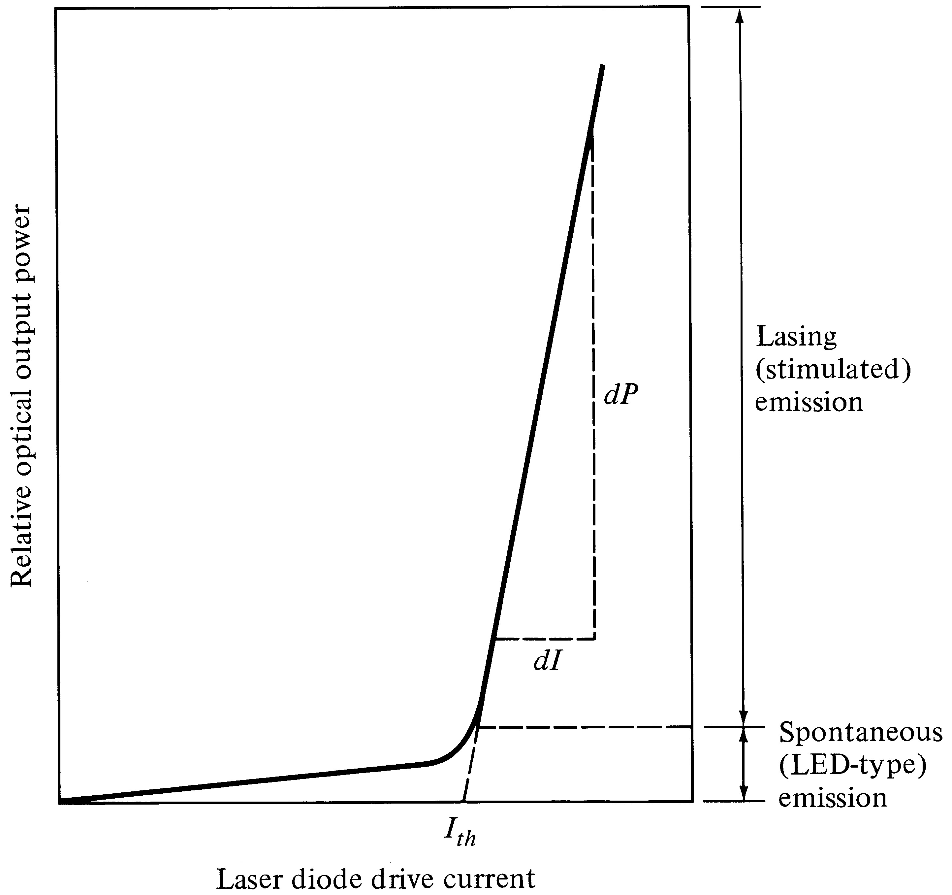
Optical output vs. drive current
Optical Fiber communications, 3rd ed.,G.Keiser,McGrawHill, 2000

Slide 5

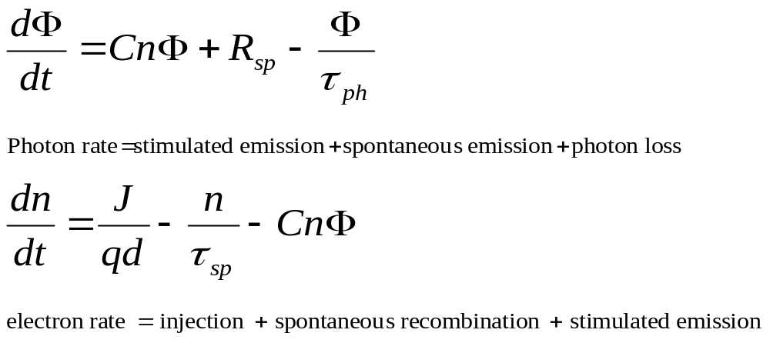
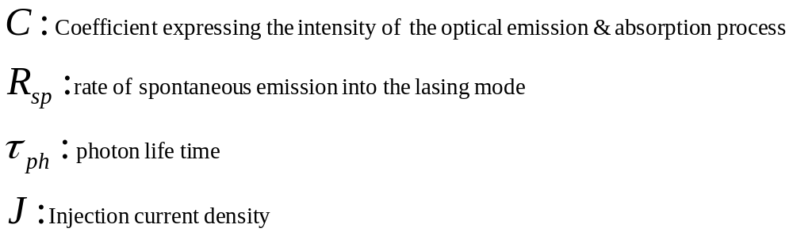
Semiconductor laser rate equations
Rate equations relate the optical output power, or # of photons per unit volume, , to the diode drive current or # of injected electrons per unit volume, n. For active (carrier confinement) region of depth d, the rate equations are:
[4-25]

Slide 6
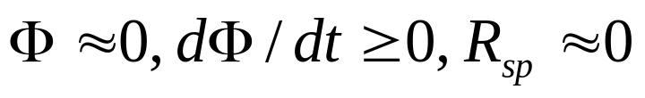
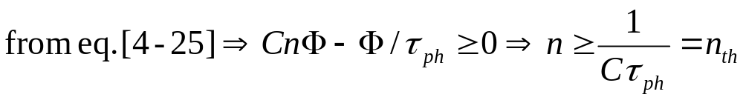
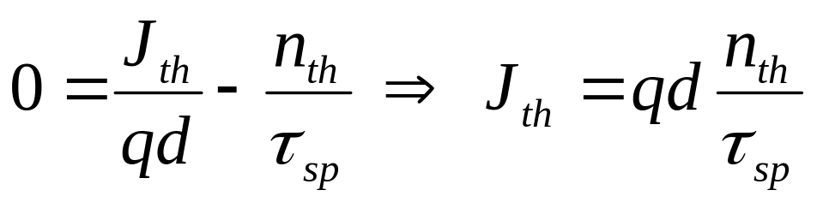
Threshold current Density & excess electron density
At the threshold of lasing:
The threshold current needed to maintain a steady state threshold concentration of the excess electron, is found from electron rate equation under steady state condition dn/dt=0 when the laser is just about to lase:
[4-26]
[4-27]

Slide 7
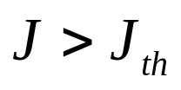
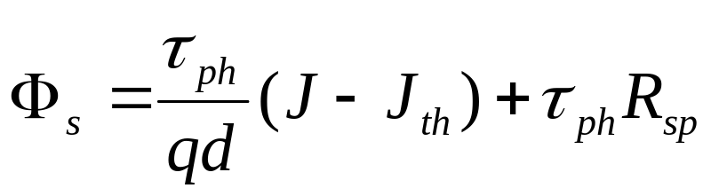
Laser operation beyond the threshold
The solution of the rate equations [4-25] gives the steady state photon density, resulting from stimulated emission and spontaneous emission as follows:
[4-28]

Slide 8
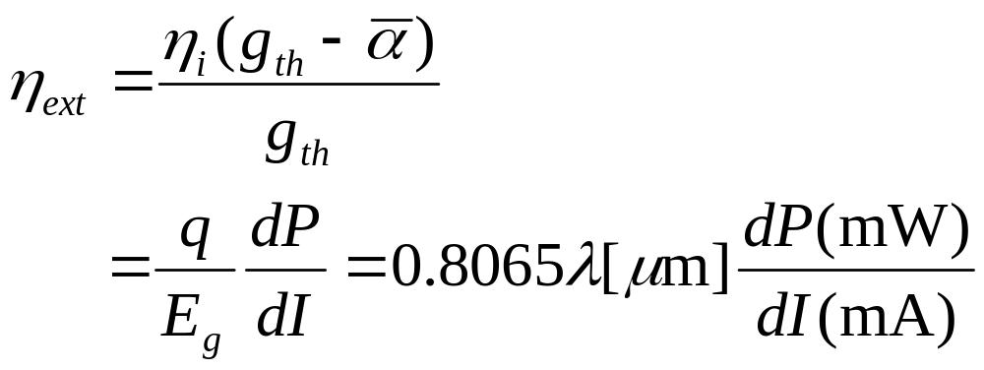
External quantum efficiency
Number of photons emitted per radiative electron-hole pair recombination above threshold, gives us the external quantum efficiency.
Note that:
[4-29]

Slide 9
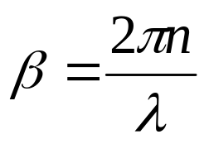
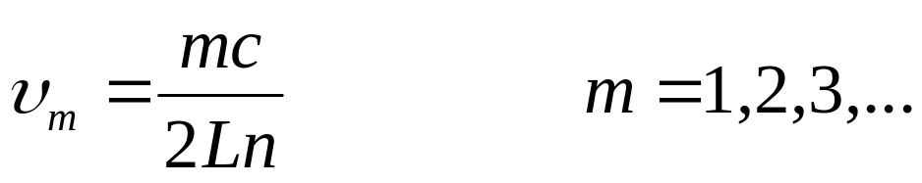
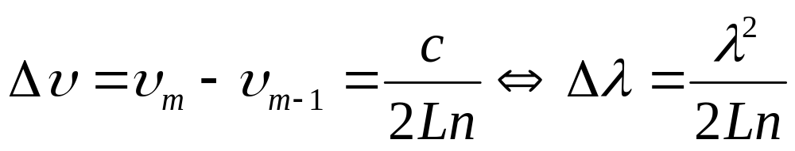
Laser Resonant Frequencies
Lasing condition, namely eq. [4-22]:
Assuming the resonant frequency of the mth mode is:
[4-30]
[4-31]

Slide 10
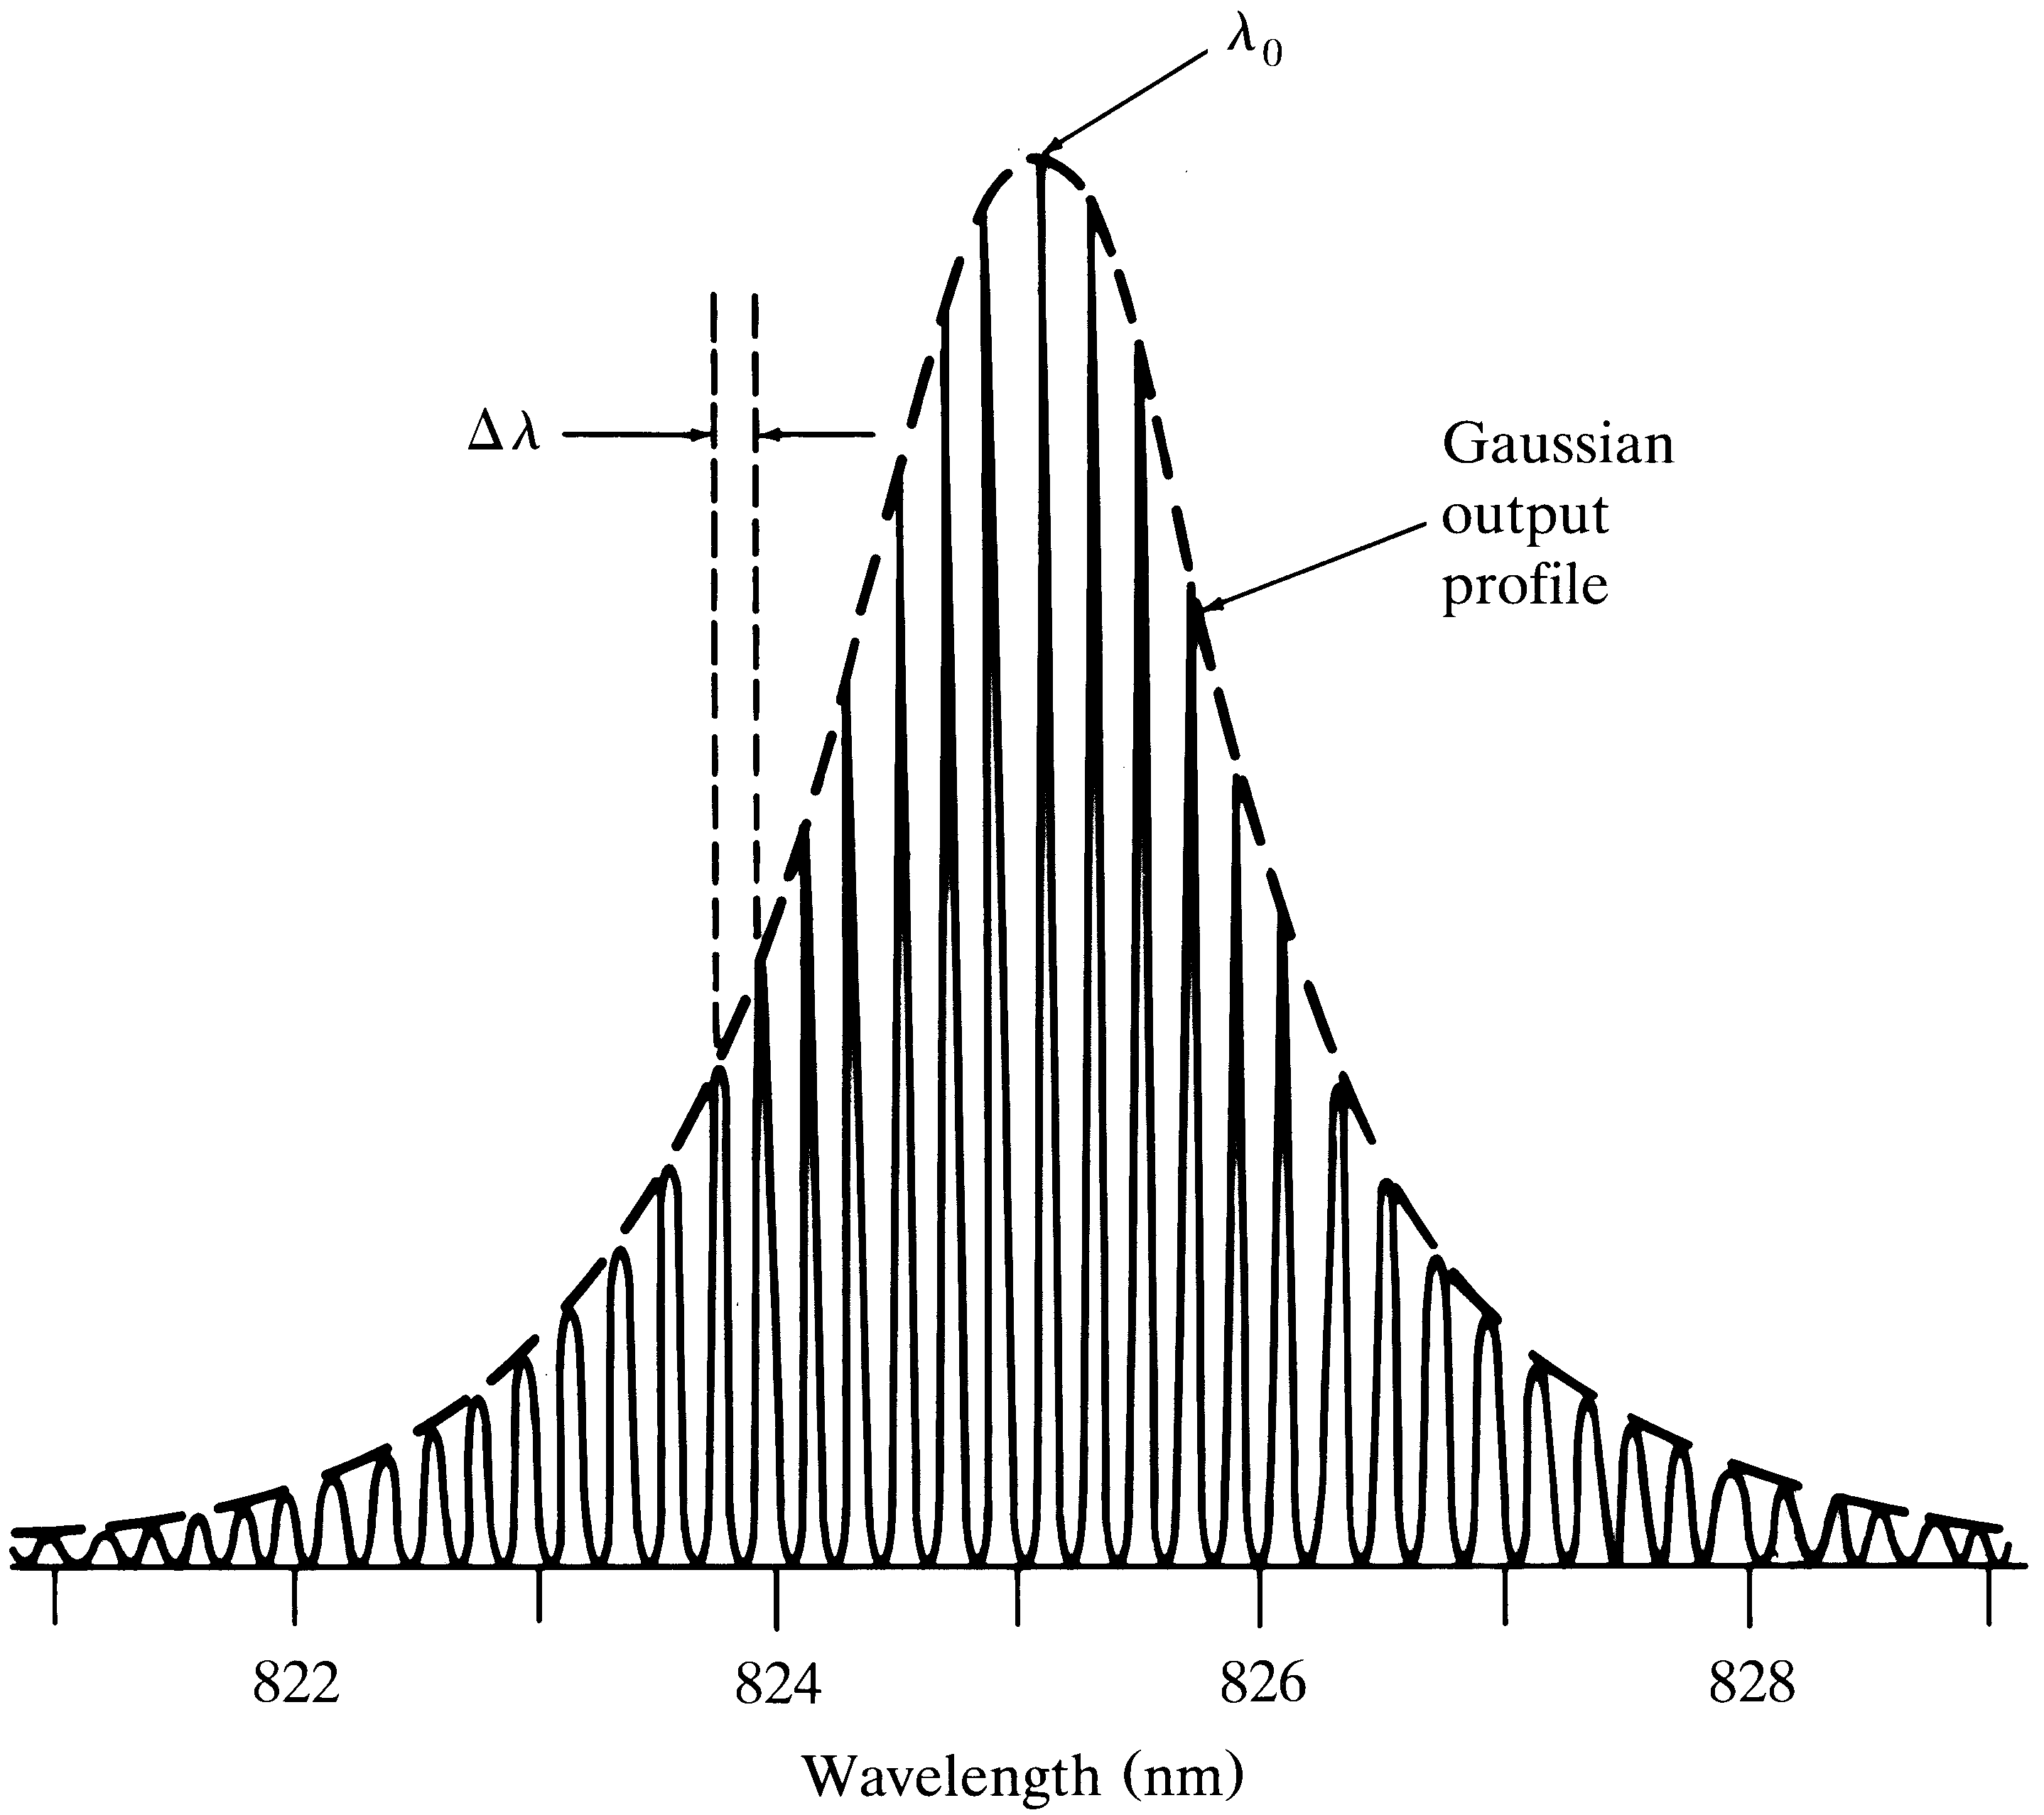
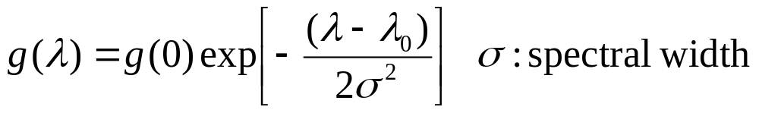
Spectrum from a laser Diode
[4-32]

Slide 11
Laser Diode Structure & Radiation Pattern
Efficient operation of a laser diode requires reducing the # of lateral modes, stabilizing the gain for lateral modes as well as lowering the threshold current. These are met by structures that confine the optical wave, carrier concentration and current flow in the lateral direction. The important types of laser diodes are: gain-induced, positive index guided, and negative index guided.

Slide 12
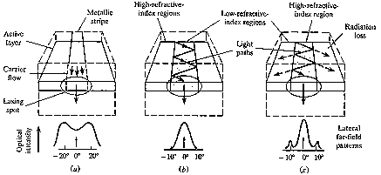
(a) gain-induced guide (b)positive-index waveguide (c)negative-index waveguide

Slide 13
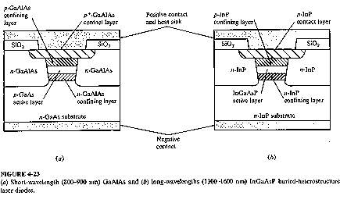
Laser Diode with buried heterostructure (BH)

Slide 14
Single Mode Laser
Single mode laser is mostly based on the index-guided structure that supports only the fundamental transverse mode and the fundamental longitudinal mode. In order to make single mode laser we have four options:
1- Reducing the length of the cavity to the point where the frequency separation given in eq[4-31] of the adjacent modes is larger than the laser transition line width. This is hard to handle for fabrication and results in low output power.
2- Vertical-Cavity Surface Emitting laser (VCSEL)
3- Structures with built-in frequency selective grating
4- tunable laser diodes
.

Slide 15
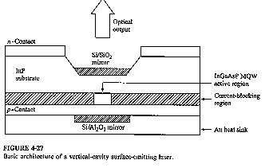
VCSEL

Slide 16
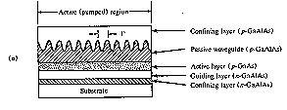
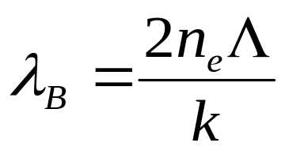
Frequency-Selective laser Diodes:
Distributed Feedback (DFB) laser
[4-33]

Slide 17
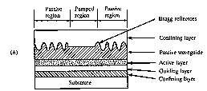
Frequency-Selective laser Diodes:
Distributed Feedback Reflector (DBR) laser

Slide 18
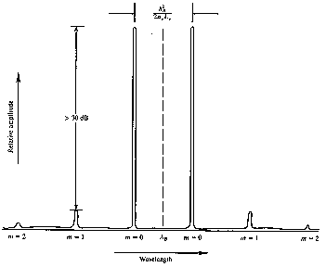
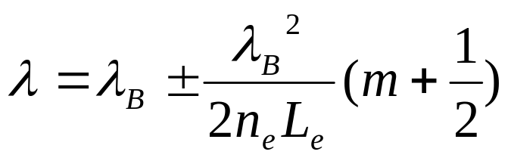
[4-35]
Output spectrum symmetrically distributed around Bragg wavelength in an idealized DFB laser diode

Slide 19
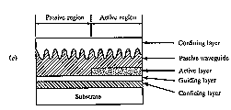
Frequency-Selective laser Diodes:
Distributed Reflector (DR) laser

Slide 20
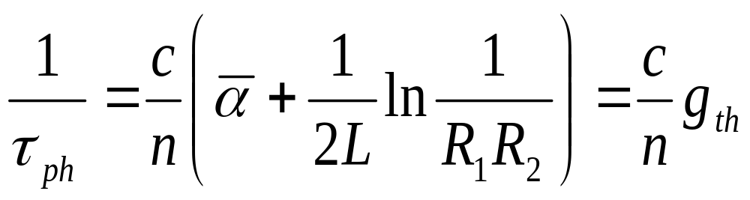
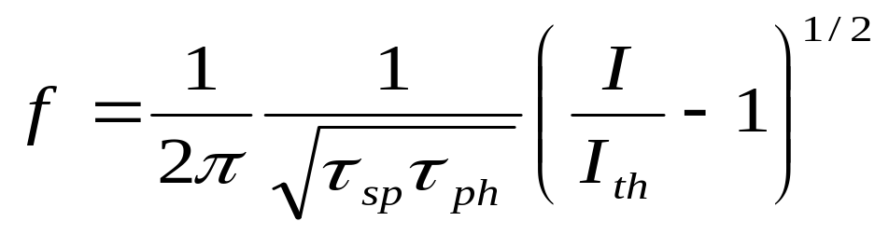
Modulation of Laser Diodes
Internal Modulation: Simple but suffers from non-linear effects.
External Modulation: for rates greater than 2 Gb/s, more complex, higher performance.
Most fundamental limit for the modulation rate is set by the photon life time in the laser cavity:
Another fundamental limit on modulation frequency is the relaxation oscillation frequency given by:
[4-36]
[4-37]

Slide 21
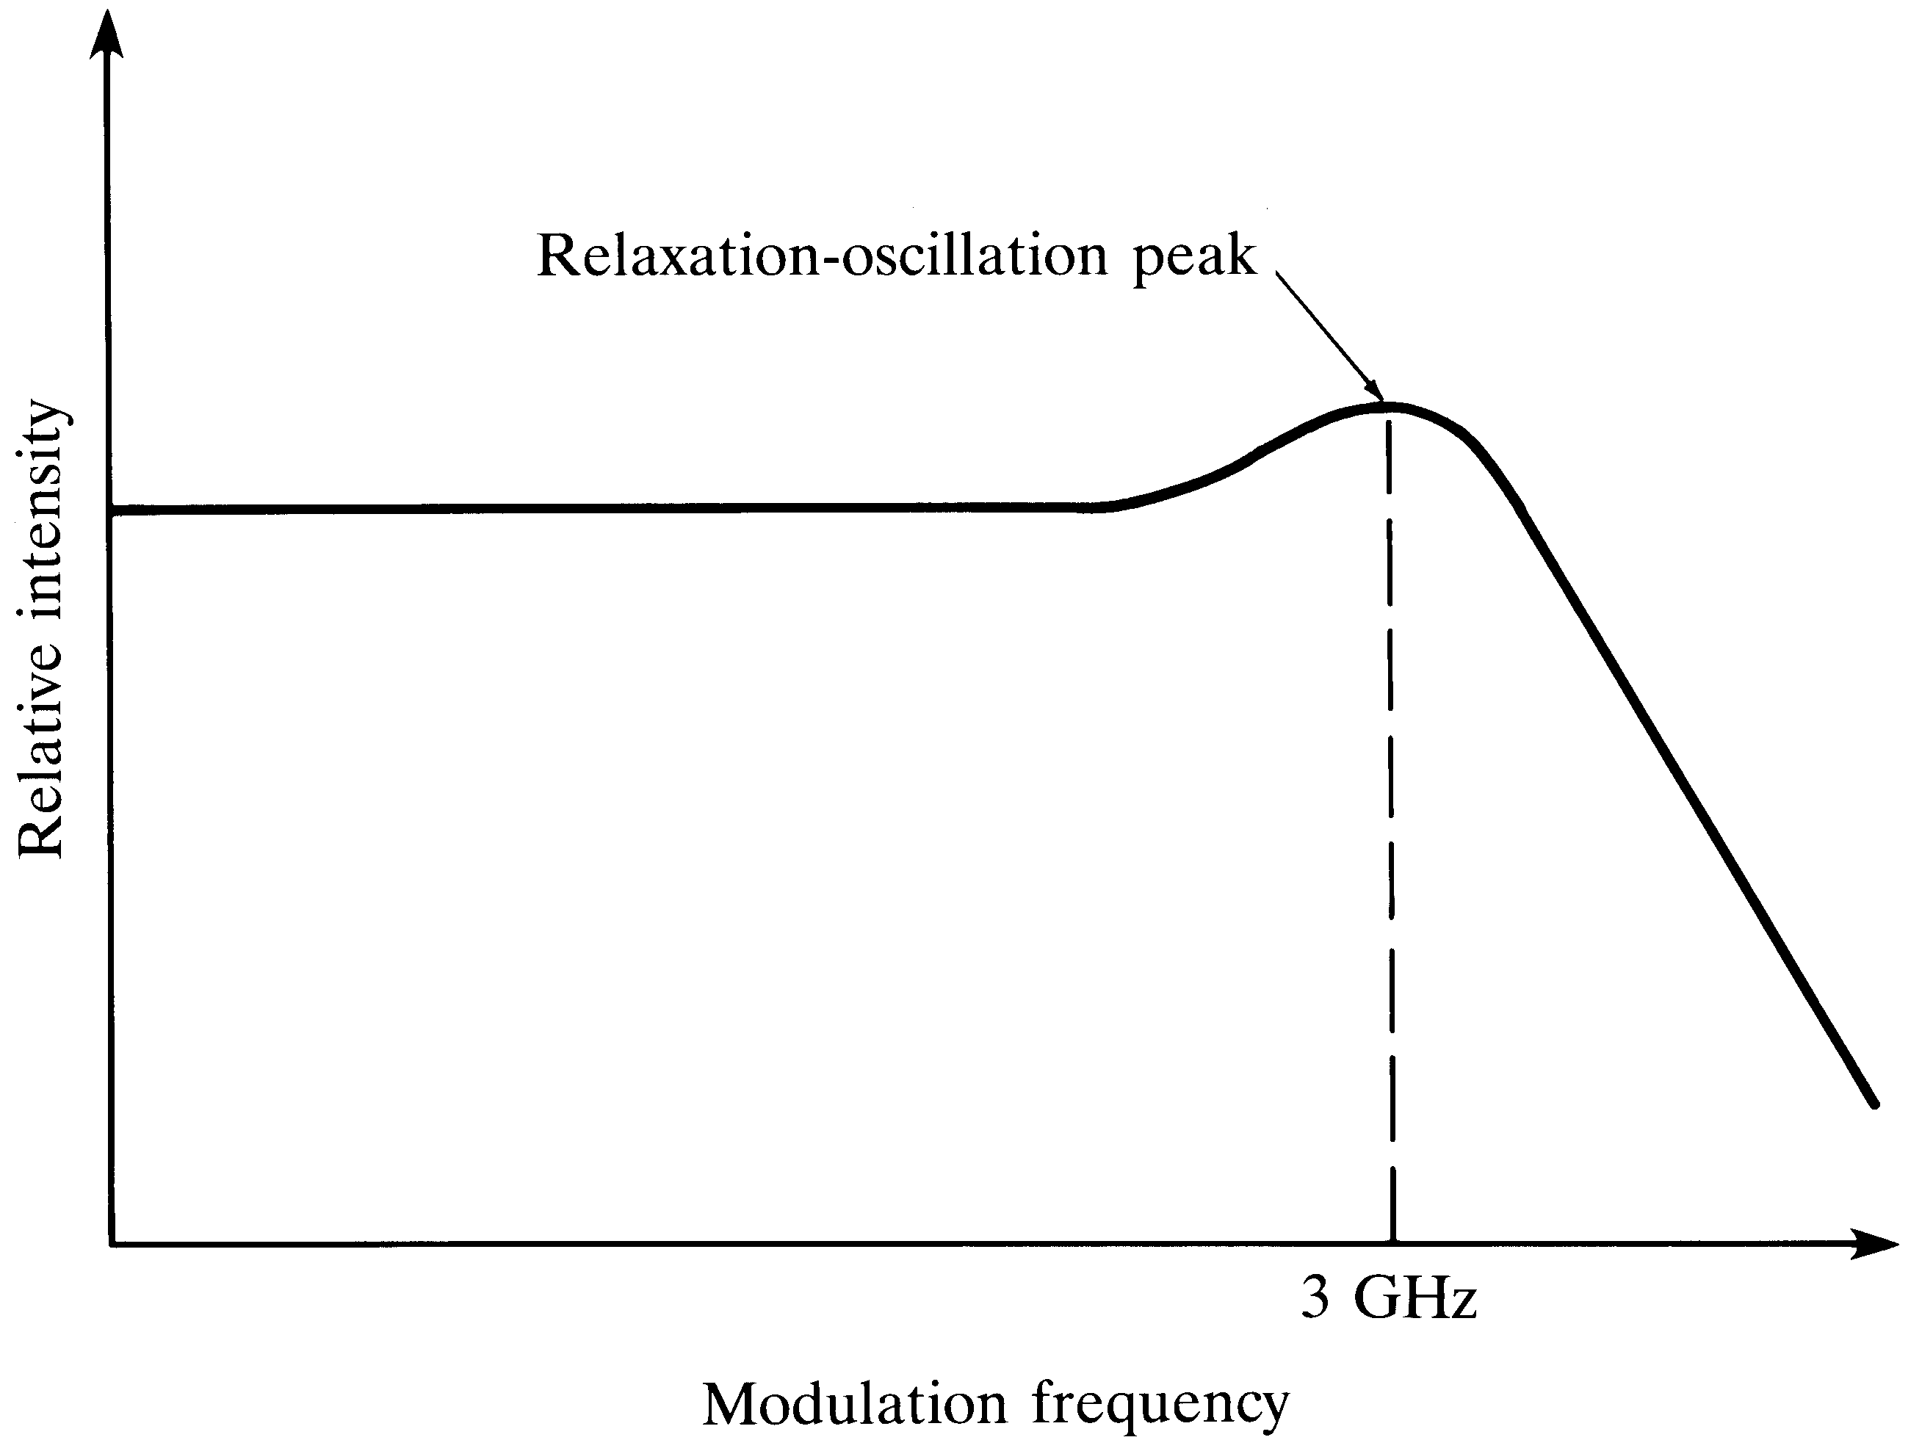
Relaxation oscillation peak

Slide 22

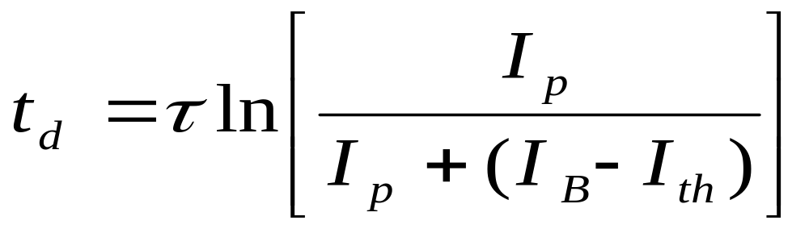
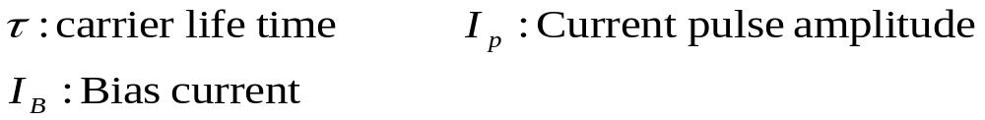
Pulse Modulated laser
In a pulse modulated laser, if the laser is completely turned off after each pulse, after onset of the current pulse, a time delay, given by:
[4-38]

Slide 23
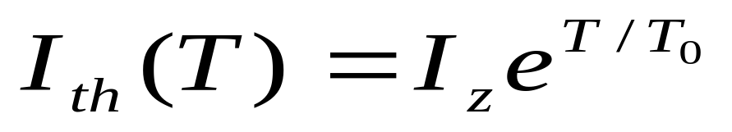
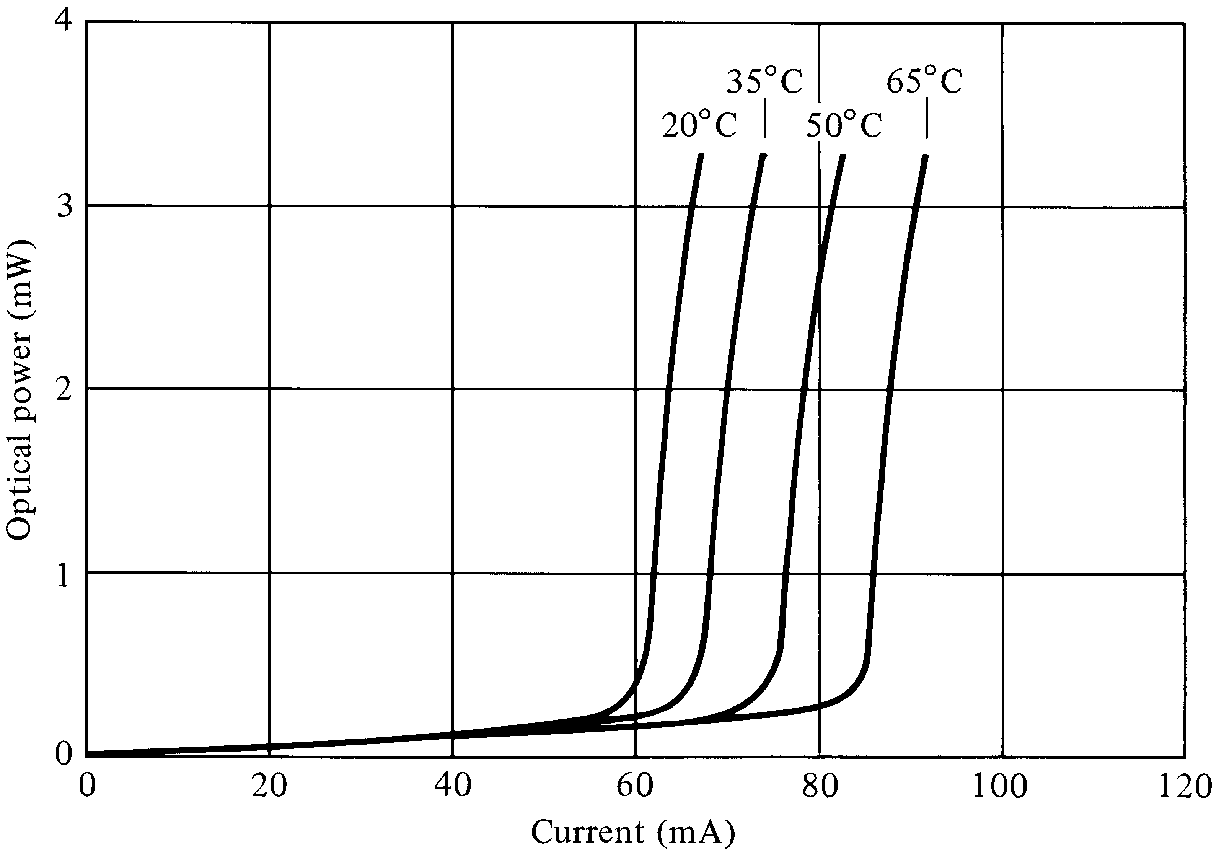
Temperature variation of the threshold current

Slide 24
Linearity of Laser
Information carrying
electrical signal s(t)
LED or Laser diode
modulator
Optical putput power:
P(t)=P[1+ms(t)]

Slide 25
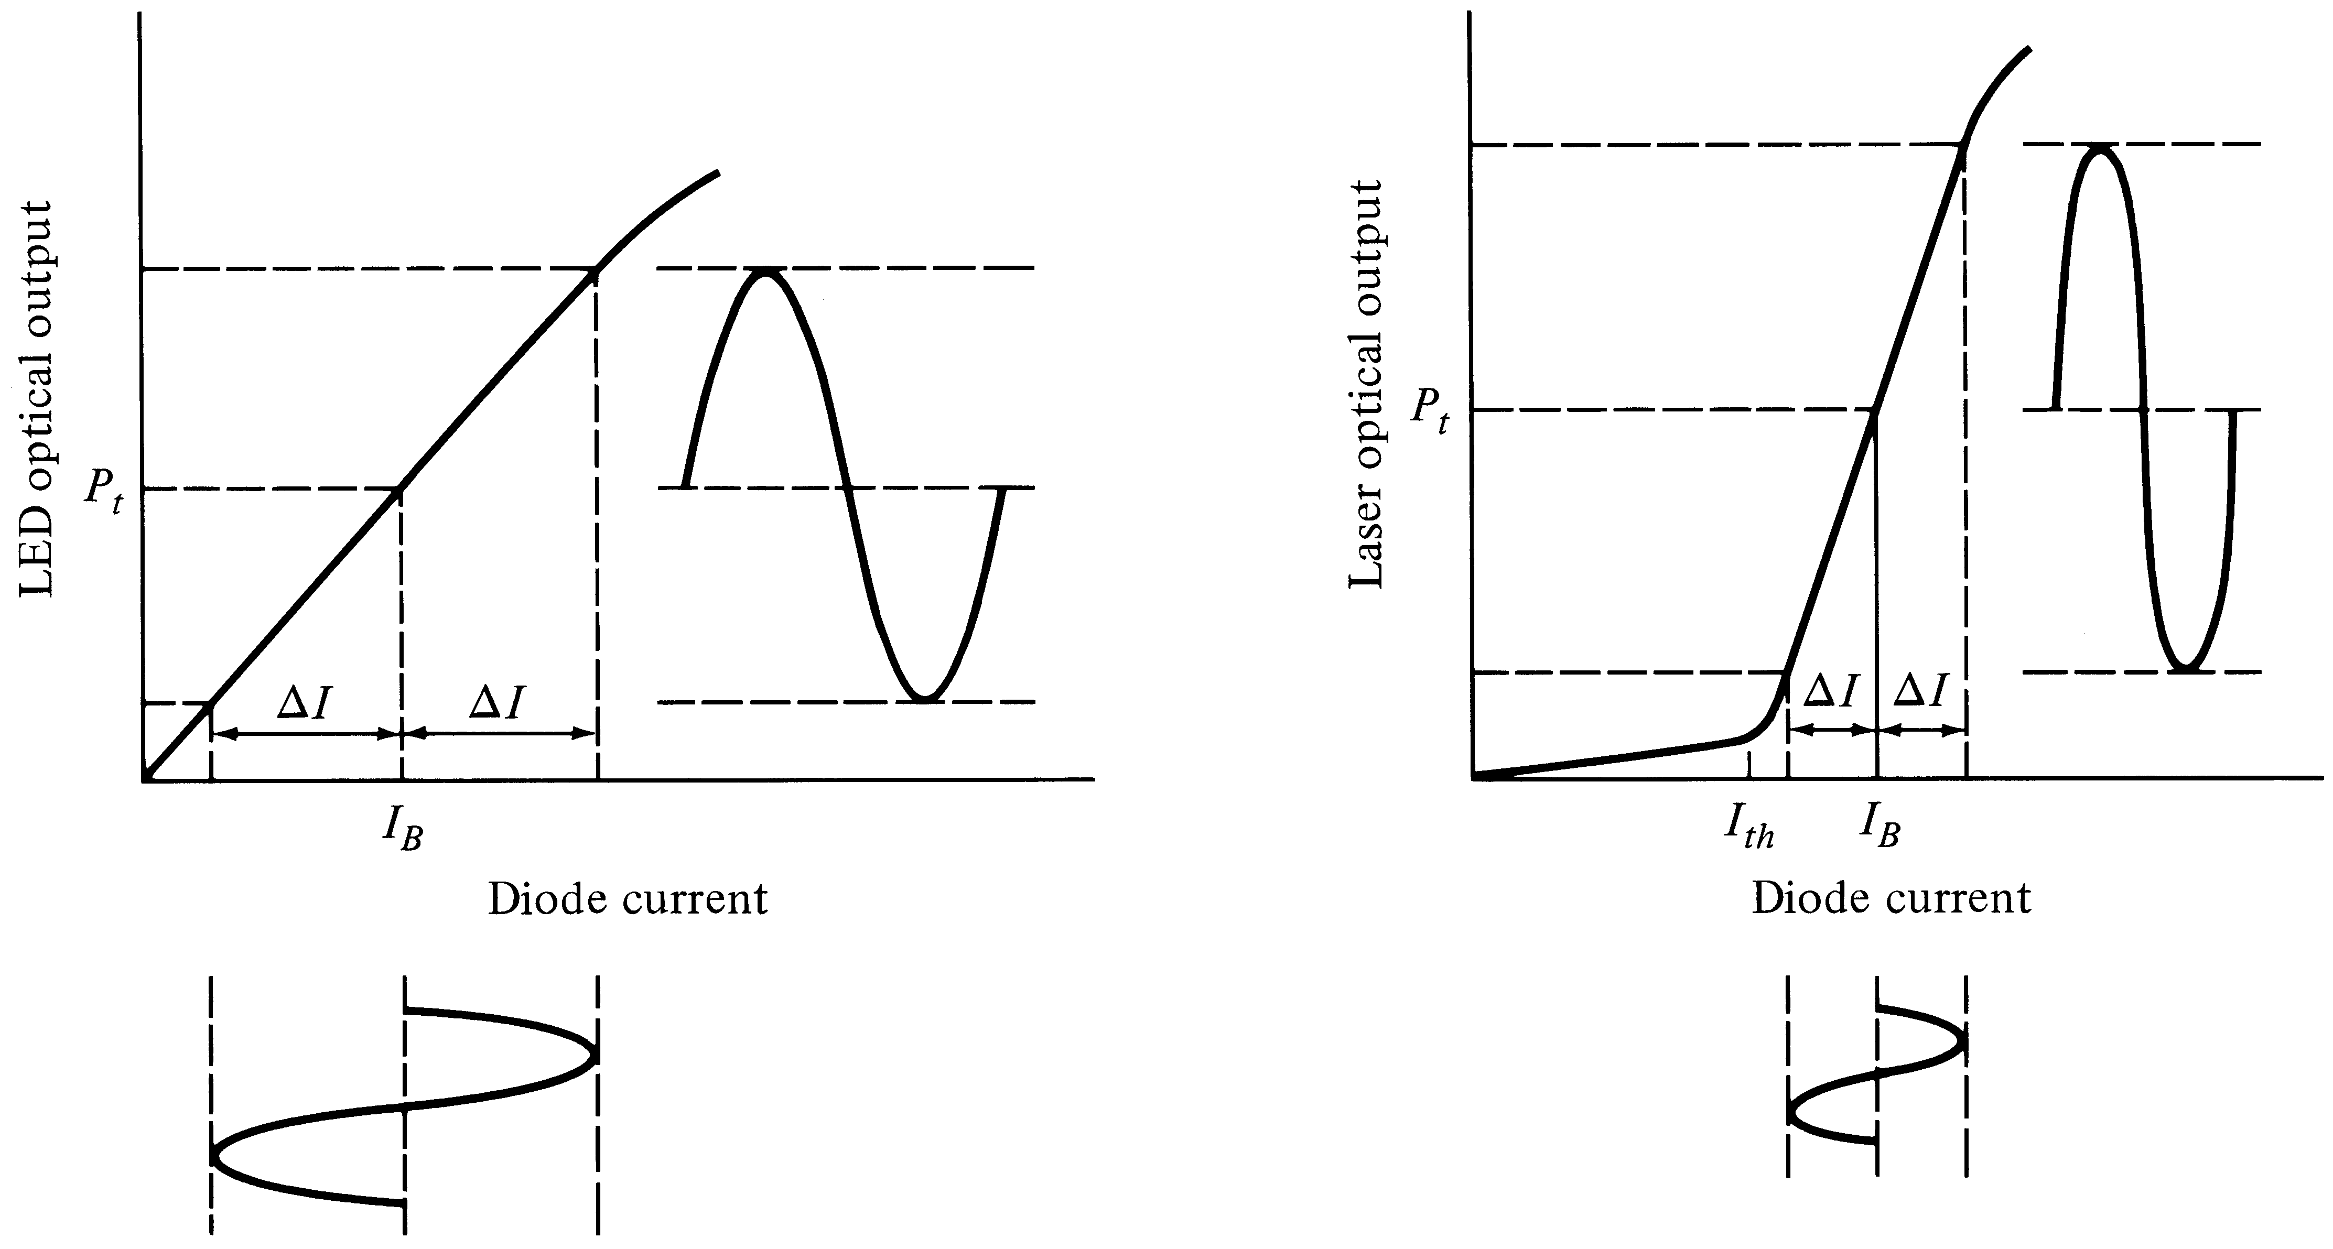

Slide 26
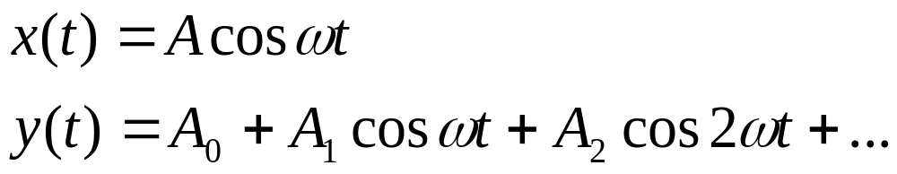
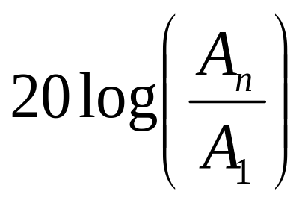
Nonlinearity
x(t)
Nonlinear function y=f(x)
y(t)
Nth order harmonic distortion:

Slide 27
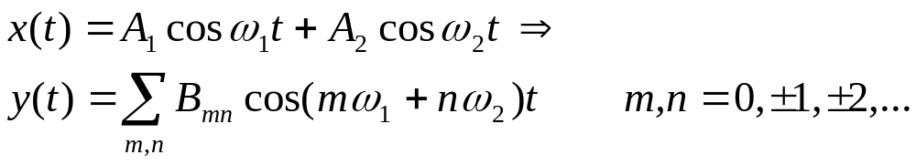
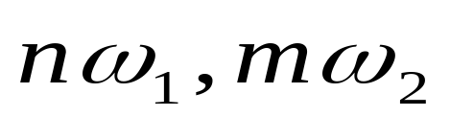
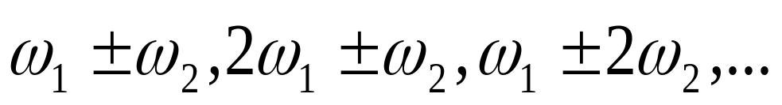
Intermodulation Distortion
Harmonics:
Intermodulated Terms:

